Slide 1
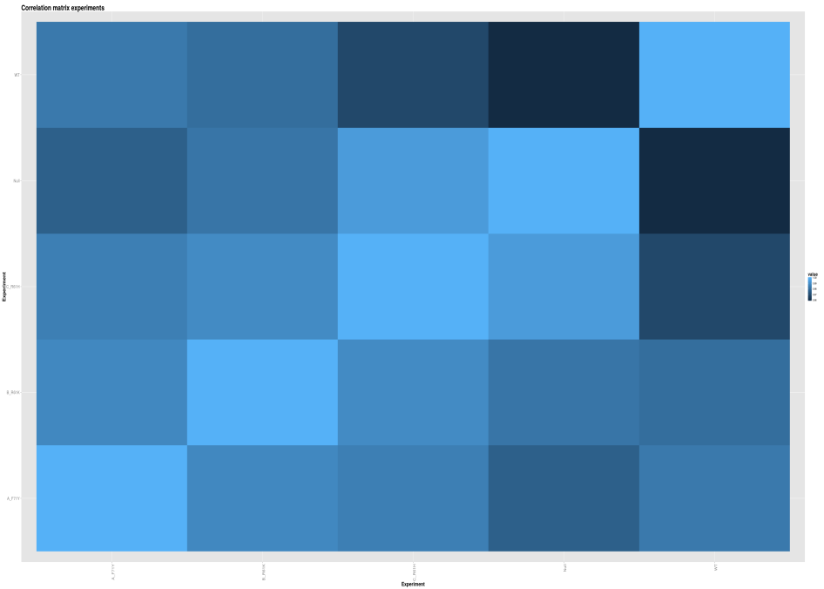
RNA-seq
RNA-seq analysis
for Prokaryotes
Anne de Jong
2015

Slide 2
Measuring gene expression
What can we do with RNA-seq analysis
  Transcription Start points (TTS)
  Transcription Termination (TT)
  Operon structures (Transcription Active Regions (TARs))
  tRNAs
  rRNAs
  Discover ncRNA’s
  Gene Expression
Here we focus on the last item: “Gene Expression”

Slide 3
Measuring gene expression
What to do
  Grow cells and freeze (liquid Nitrogen) them at point X
  Isolate total RNA
  Optional rRNA depletion
  Library Prep (cDNA)
  Sequencing (Illumina, IonProton)
  Filter, trim, map the sequence reads to a reference genome
  Gene expression calling
All steps above can be standardized, just follow the protocols

Slide 4

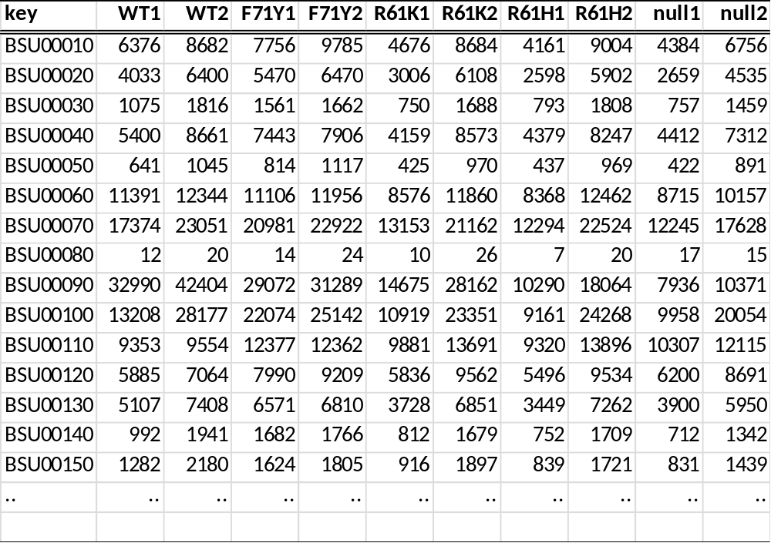
Gene expression values
Starting point: Excel file with gene expression values
( RPKM/FPKM/TPM/Counts )
Rows are the features (genes)
Columns are the experiments (samples)
Tutorial
Step1:
Goto http://genome2d.molgenrug.nl
In menu RNA-seq analysis;
download the “example data set”
Open the file RPKM.txt in Excel
What do the numbers represent?

Slide 5
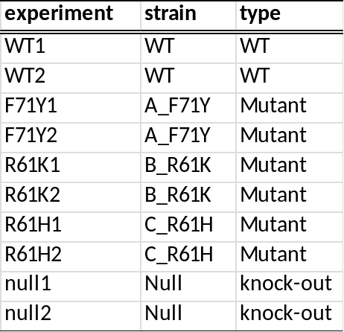
The factors
The factors describe the experiment
  What are the replicates
  What is the biological meaning
  Multiple factors possible
Factor-1
Factor-2
Tutorial
Step 2:
In this example we only use Factor-1. Open Factos.txt in Excel
What do these Factors mean?

Slide 6
Contrasts
The factors describe the data, next step is to ask questions
  Which genes are differential expressed between WT and one or more mutants?
  Is there a global effect?
  Which mutants are highly correlated?
To answer these questions the contrasts needs to be defined
A_F71Y-WT
B_R61K-WT
C_R61H-WT
null-WT
In this example all samples are compared to the WT
Factors file
Tutorial
Step 3:
Open the file Contrasts.txt in Excel
Make a Contrasts file if you use Factor-2 (type) instead of Factor-1 [see previous slide]

Slide 7
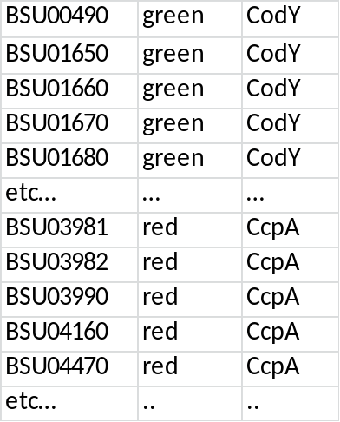
Classes
Adding literature data to the analyses
One way is to define groups of genes/proteins that have a biological relation
  Metabolic pathway; KEGG
  Related protein domains; e.g. ABC transporters
  Regulons
  Related processes; e.g. sporulation
  Any defined group of genes is possible
These groups of genes are called Classes
Class file
Tutorial
Step 4:
Open the file Classes.txt in Excel
Define your own class for at least 20 genes
e.g. the best hits found by Brinsbane

Slide 8
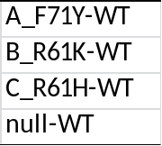
Overview
Now we have 4 files
Gene expression file
Contrasts file
Contrasts file
Factors file
Class file
Factors file
Tutorial
Step 4:
Open the file Classes.txt in Excel
Define two or more classes for at least 10 genes in total

Slide 9
Flow chart of the Analysis
RPKMs
Factors
Contrasts
Class
Project name
User input
RNA-seq Analysis Pipeline (Genome2D webserver or R-script)
RESULTS
Global Analysis
Normalization
Library Sizes
PCA/MDS
Contrasts
Differential Expression
Volcano Plots
MA Plots
Heatmaps
Experiment Analysis
Correlation Matrix
Heatmap of Experiments
K-means Clustering
Class Analysis
Correlation Matrices
Mean Signal Plots
Heatmaps of
Top Hits
Signals
Class Groups
K-means Clustering
Tables
Tab delimited
Html formatted
Downstream Analysis
Functional Analysis on the Genome2D webserver
TIGR Multi Experiment Viewer
Etc..

Slide 10
Performing a RNA-seq analysis
The pipeline is available as R-script or as webserver
The R-script allows modification of settings and parameters
The webserver is parameter free
  parameters are predefined, will be calculated or estimated on the fly
Tutorial
Step 6:
Open the webserver http://genome2d.molgenrug.nl
Goto to RNA-seq analysis and download the example data set
Subsequently, upload these four files for analysis
Give the project a logical (short) name
Press start run and wait 1-2 min for the results

Slide 11
Mining the results
The results are divided in 5 sections
  Global analysis
  Contrasts analysis
  Experiment analysis
  Class analysis
  Data tables
  Functional analysis
Tutorial
Step 7: Global analysis
For this RNA-seq experiment we asked for at least 4M (Million) reads per experiment. Did all samples passed this criteria?
Which sample duplicates showed the lowest dispersion

Slide 12
Mining the results
The results are divided in 5 sections
  Global analysis
  Contrasts analysis
  Experiment analysis
  Class analysis
  Data tables
  Functional analysis
Tutorial
Step 8: Contrasts analysis
Which CodY mutant showed the lowest number of significant changed genes?
What is the highest fold change of a gene when the Wild Type was compared to the knock-out
Volcano plots are used to visualize Fold change and there cognate p-value. Open a volcano plot and write a good legend for this Figure.
On the left side of Heatmaps of TopHits, you see a Dendrogram. What is the meaning of the length of lines in a Dendrogram?

Slide 13
Mining the results
The results are divided in 5 sections
  Global analysis
  Contrasts analysis
  Experiment analysis
  Class analysis
  Data tables
  Functional analysis
Tutorial
Step 9: Experiment analysis
Correlation matrix of experiments is a visualization method to show the overall Pearson’s correlation between experiments. Write a legend for his Figure and include a description what the shades of blue represent.
K-means clustering groups genes having a good correlation over multiple experiments. The Threshold of separation groups is always arbitrary, which k-means groups could optionally be merged to one group?

Slide 14
Mining the results
The results are divided in 5 sections
  Global analysis
  Contrasts analysis
  Experiment analysis
  Class analysis
  Data tables
  Functional analysis
Tutorial
Step 10: Class analysis
‘Correlation matrix of Classes’ gives a quick view on the behavior of Class members (genes) over the various experiments. What do the colors in these matrices mean?

Slide 15
Mining the results
The results are divided in 5 sections
  Global analysis
  Contrasts analysis
  Experiment analysis
  Class analysis
  Data tables
  Functional analysis
Tutorial
Step 11: Data tables
The data that is produced and used by the pipeline to draw graphs can be used for further analysis. Such as the popular freeware programs TMEV and Cytoscape
The file ‘Edge list for a gene network of Contrasts’ is compatible with Cytoscape but will not be discussed further.
Save the file ‘TIGR MEV TopHits log2FC’ for TMEV
Download MeV: http://www.tm4.org/mev.html

Slide 16
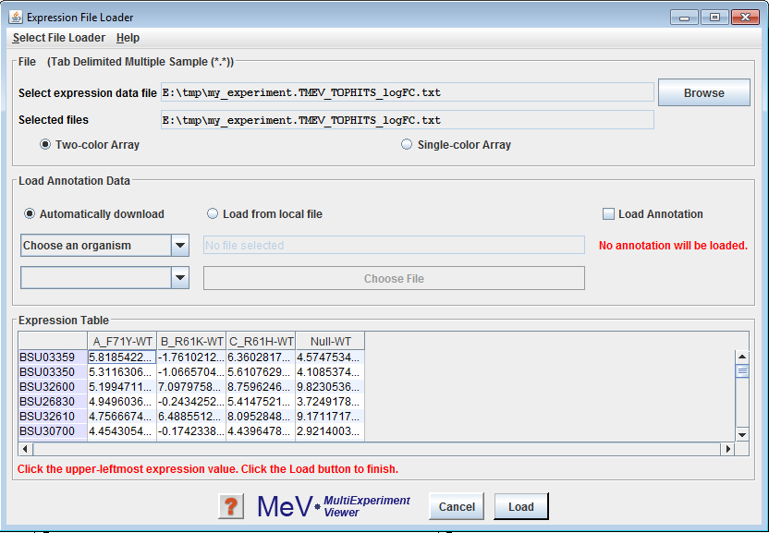
MeV; Multi experiment Viewer
Tutorial
Step 11: Using MeV
Start MeV and load the file ‘TIGR MEV TopHits log2FC’ as dual channel data (because this is ratio data)
Deselect “Load Annotation”
Press load and now the data is imported and ready to analyze using MeV
Optional: try to do a k-means clustering, here you have to estimate the number of clusters yourself

Slide 17
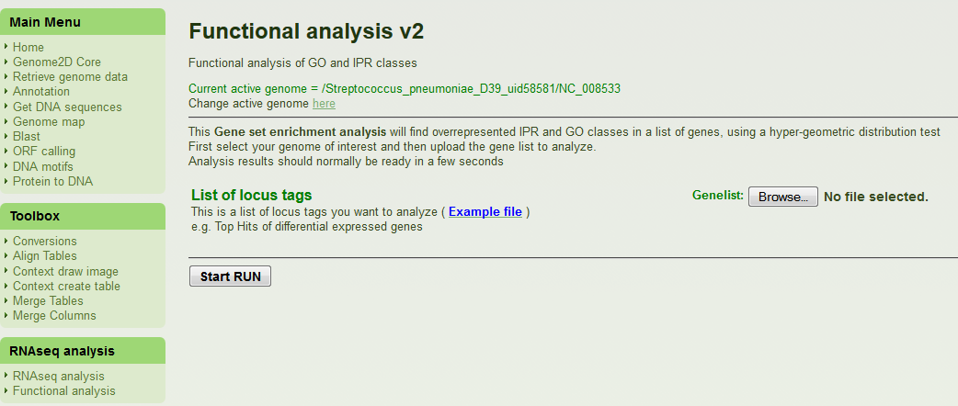
Functional Analysis
Tutorial
Step 12: Perform a functional analysis on the TopHits of one or multiple Contrasts
Change the ‘Current active genome’ to your genome of interest
Upload a list of locus tags to analyze
Examine the results and describe shortly your findings/conclusion

